Slide 2
CODE AT SCALE
By Joel Dickson

Slide 3
INSTRUCTIONS FOR USE
What works for us might not work for you…
It all depends on your context
Try it!.. The worst thing that can happen is that you will learn something

Slide 4
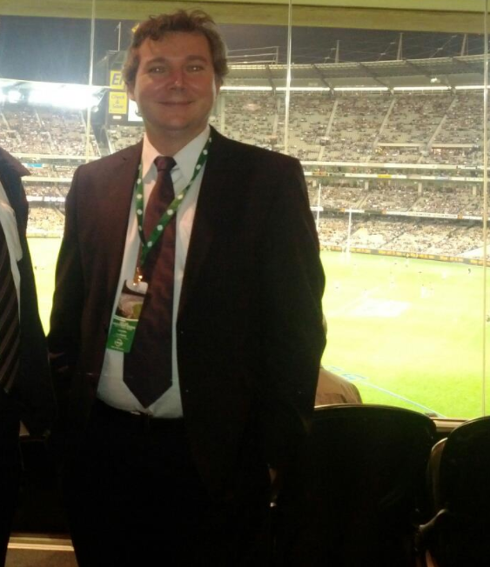
About Me
Development Manager at Agoda
Work on the Agoda Homes Project
NUnit Contributor
Coming to Thailand for 10 years for business
Originally from Australia
I live in Bangkok
I like Beer and Sport

Slide 5

MY PROMISE TO YOU
There will be no Rainbows and Unicorns in this presentation
I will talk about the hard reality of programming on a dotnet Megalith

Slide 6
WHAT IS CODE AT SCALE?
Its not about How many servers you have
It’s above volume of change on a code base
You will have challenges with Build, Deployments, Quality, etc.
Today I will talk about the Code Quality challenges

Slide 7
1.
THE PROBLEM
Developers, Developers, Developers!

Slide 8

1,000,000
150
130+
Lines of Code - 25% TS / 75% C#
https://www.agoda.com
Active Weekly Contributors (FT)
Pull Request Per Week

Slide 9
100% YoY Developer growth in 2016
More than 50% of the developers had been at the company less than a year

Slide 10

ON BOARDING
Question
How long does it take when a developer starts at your company before they are pushing production code?

Slide 11
MOVING TO MORE COLLABORATION
The required transition we had to make
Strong Code Ownership
Weak Code Ownership
Collective Code Ownership
Pull Request Culture
Similar to OS Communities
* https://martinfowler.com/bliki/CodeOwnership.html

Slide 12

PULL REQUEST CULTURE
Question
You git clone a project you have never seen before, how do you learn about a new code base?
Notes:
You look at the code right? Learn from seeing what they are doing already, what if the piece you are looking at is one that we don’t want anymore

Slide 13

That guy? He left 3 years ago…

Slide 14
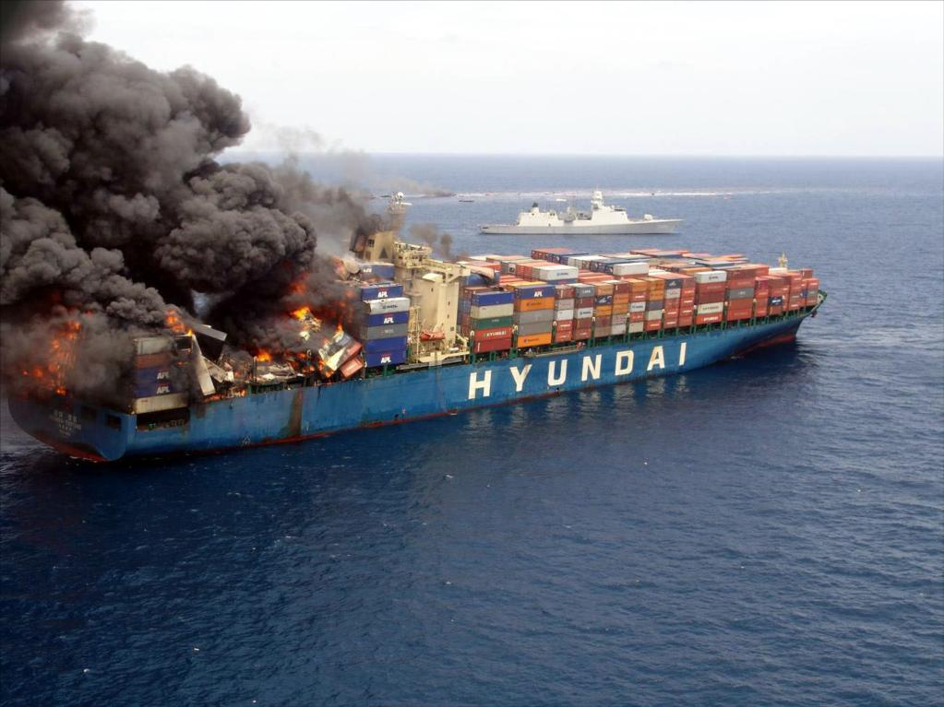
What does a 5 year old code base, this size, look like?

Slide 15
2.
HOW DO YOU MEASURE THIS?
CODE THAT MAKES ME EYES HURT

Slide 16
WE MUST MEASURE
If we don’t have a way to measure -
How do we know when we are done?
How do we know successful we are?
How do we know which is the best course of action?

Slide 17
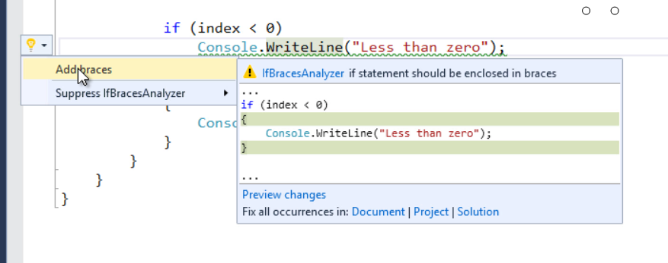
ROSLYN
Roslyn Analyzers
Measures issues with C#
Good set of base rules that ship with VS
https://github.com/DotNetAnalyzers

Slide 18

TSLINT
Various good rule sets on the market you can reuse
AirBnB have some good ones!
react-tslint, tslint-eslint-rules, tslint-consistent-codestyle, tslint-microsoft-contrib, tslint-refactor

Slide 19
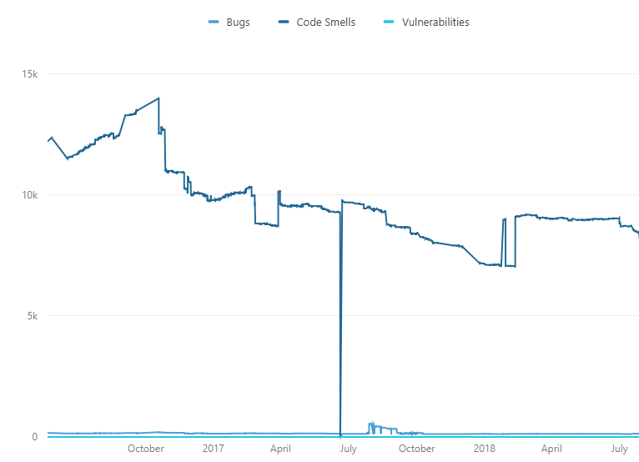
SONARQUBE
Measurements and historical reporting based on your rules

Slide 20
COMING SOON TO SONARQUBE
Gamification
Grant points to users for every positive impact that they see on their “My Activity” page. Those points will allow them to rank themselves against their teammates, creating the friendly competition that one can expect from such gamification process.
achievement badges that will be visible on the developer page. Be ready to see some “Coverage Ninja” or “Bug Killer” icons!

Slide 21
SONAREQUBE === BUTT HURT
Importing customer Typescript rules
https://beerandserversdontmix.com/2018/02/03/importing-custom-typescript-tslint-rules-into-sonarqube/
Multi Language projects
https://beerandserversdontmix.com/2018/02/03/sonarqube-with-a-multilanguage-project-typescript-and-dotnet/

Slide 22
What’s wrong with “your” code?
Is it the same as everyone else?
… Mostly

Slide 23
OPEN SOURCE STANDARDS
Based on what we think is best practice for ASPNET development
https://agoda-com.github.io/standards-c-sharp
We think we’re pretty smart :)

Slide 24
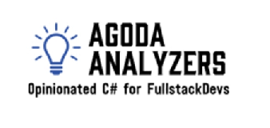
AGODA ANALYZERS
We started to develop our own Roslyn rules and code fixes
https://github.com/agoda-com/AgodaAnalyzers
See previous blog posts for how to use these with Sonarqube

Slide 25
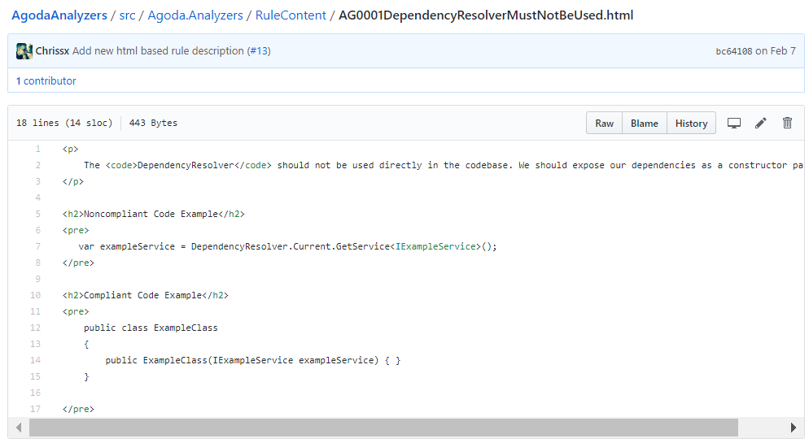
ANALYZERS MEET SONAR
Sonar adds meta data to the rules, such as documentation, examples, and rankings
Additional info stored in our repo

Slide 26
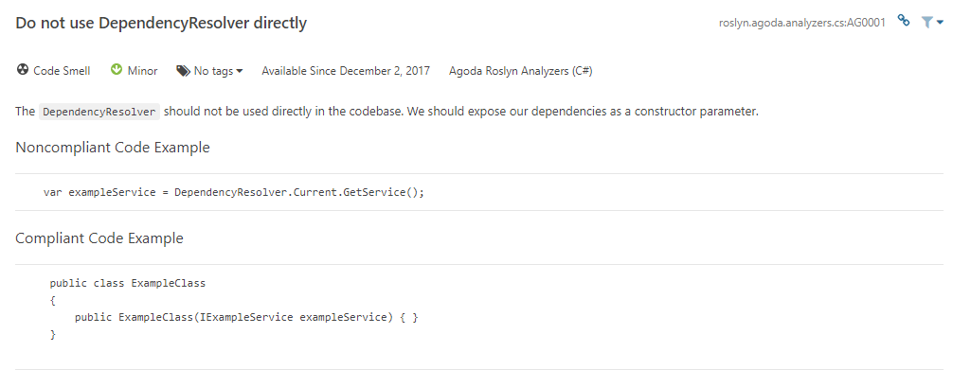
DOCUMENTATION POPULATES SONAR

Slide 27
3.
PLAN OF ATTACK
CHARGE!

Slide 28
STOP THE LEAK
Start with New Code going in

Slide 29
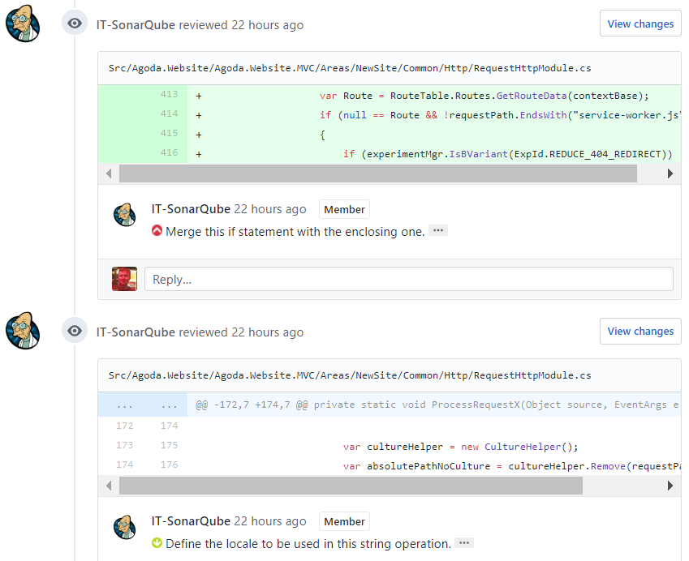
CODE REVIEW BOT
GitHub Plugin for Sonarqube
Works with any current analysis you have
C#, TS, Scala, etc
https://github.com/SonarSource/sonar-github

Slide 30
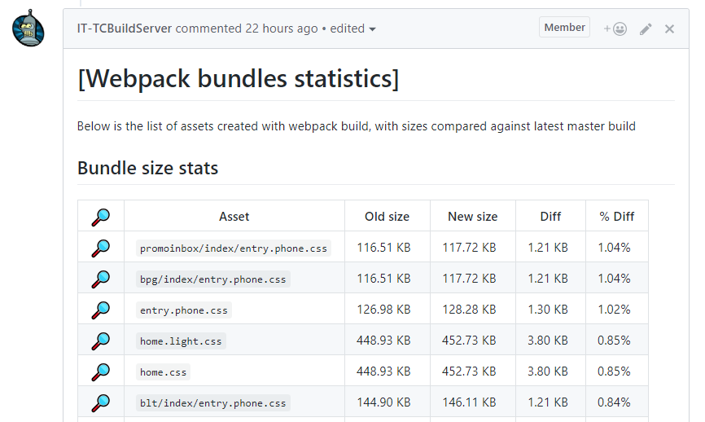
WEBPACK ANALYSIS
Webpack tools to tell you about bundle sizes
https://github.com/monkey3310/stats-webpack-markdown

Slide 31
PROJECT IMPLENTATION SPECIFICS
Example: in project X, we are migrating all Controllers from Area Y to Z
This is specific to a project, and shouldn’t be in shared analyzer projects

Slide 32
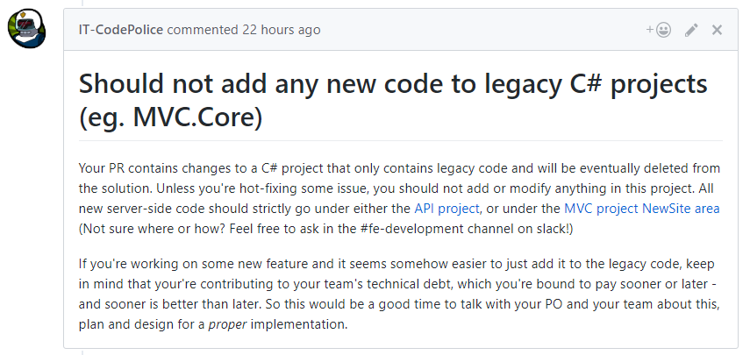
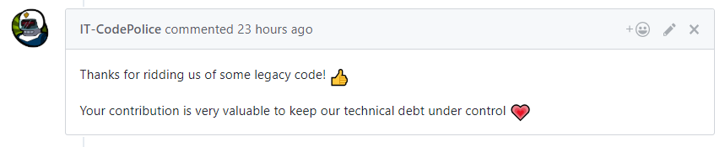
THE CODE POLICE!
Script to post custom markdown when developer are working on sensitive areas
Educational tool

Slide 33
OUR GITHUB ORG
Keep and eye on our GITHUB org for more tools as we publish them
https://github.com/agoda-com/

Slide 34
THE LONG HAUL
CLEANING UP THE OLD CODE

Slide 35
STEP 2 – THE LONG HAUL
What to do about the rest of the code base?
How do we clean up all the old code?

Slide 36
CODE DAY
1 Day per week or sprint (Timeboxed)
Team takes the day to work on solely technical tasks
Good tool for getting on-top of this

Slide 37
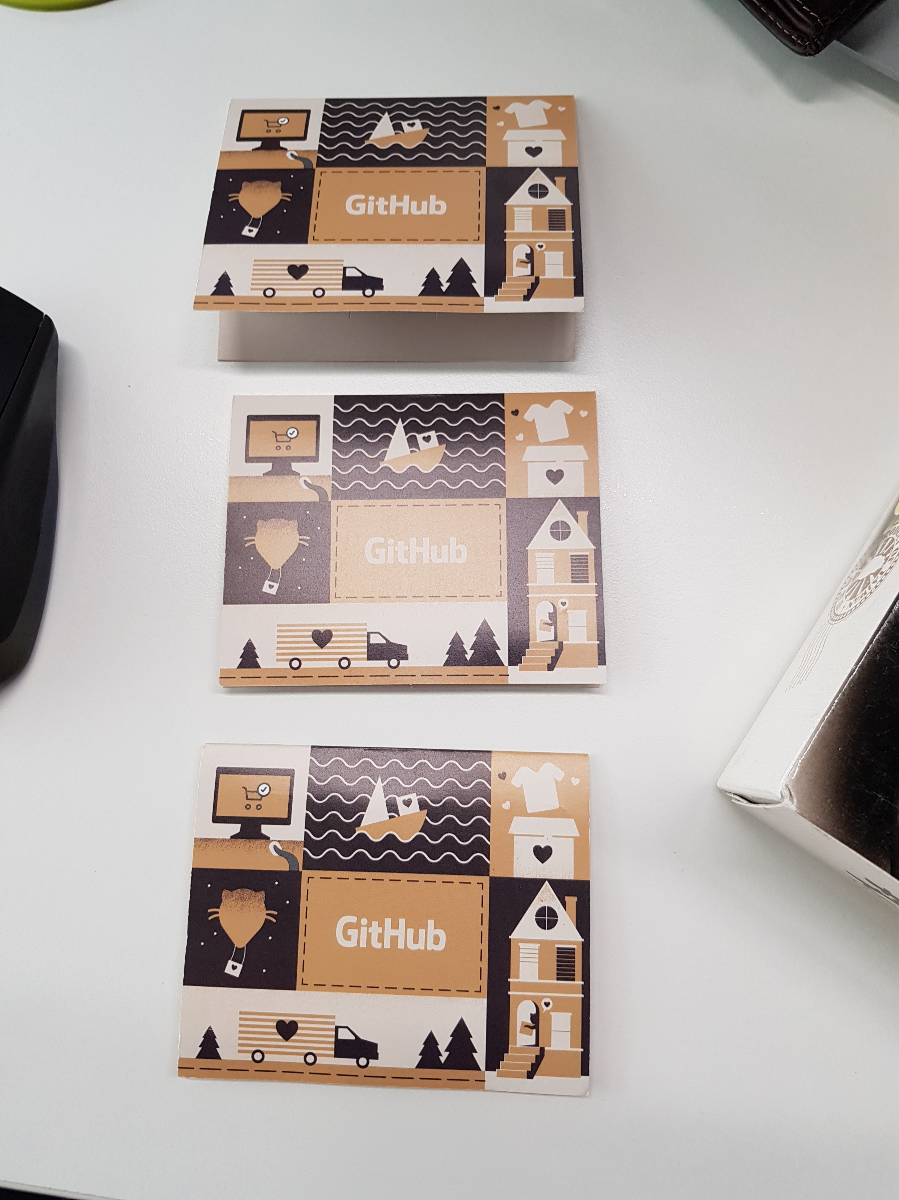
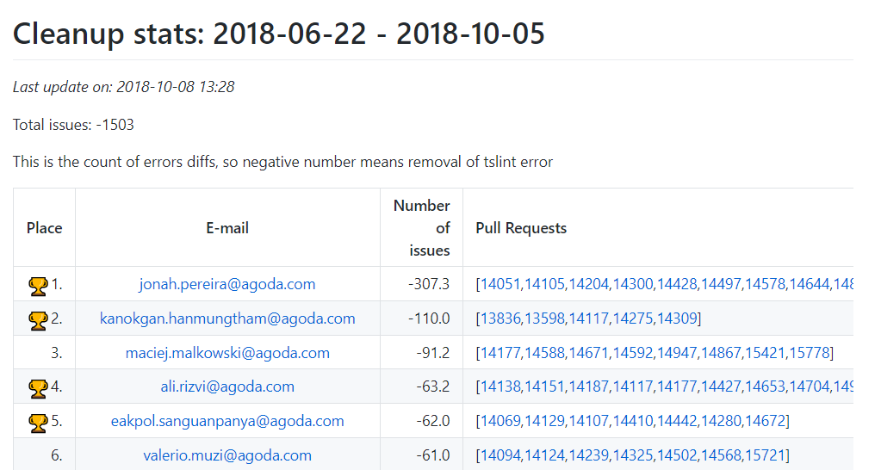

RECOGNITION AND SWAG WINS!
Leader board for Cleanup
Prizes for those that cleanup the most
Lintkeeper Stickers
GitHub T-shirts

Slide 38
SONGKRAN REFACTOR
Once a year we do large breaking changes and cleanup
Make sure you don’t have any big PRs open over the holiday
At Songkran the office is empty ;)

Slide 39
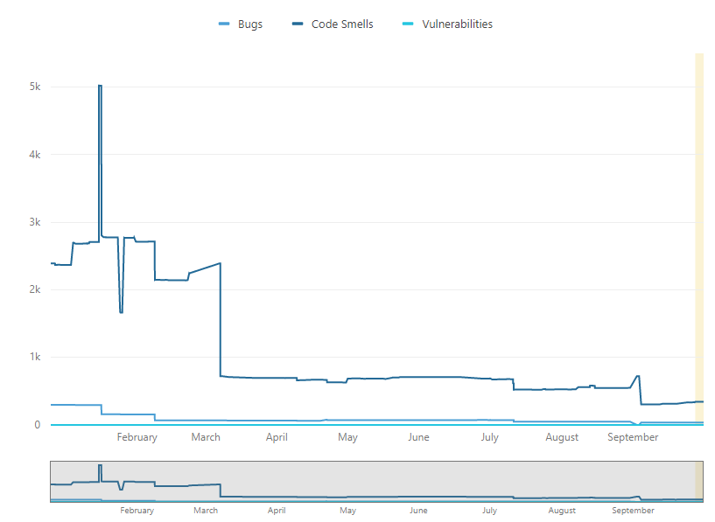
HOW ARE WE GOING TODAY
We are still going
Overall we have seen smells drop, some apps more than others

Slide 40
THANKS!
Any questions?

